Slide 1

Understanding Housing Prices and Rental Market
King Country

Slide 2
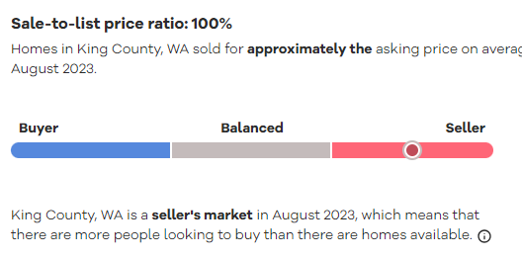
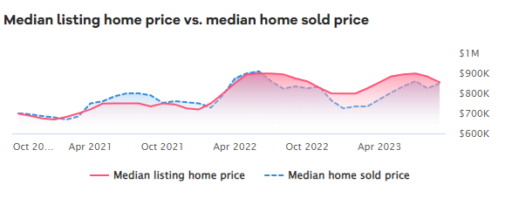
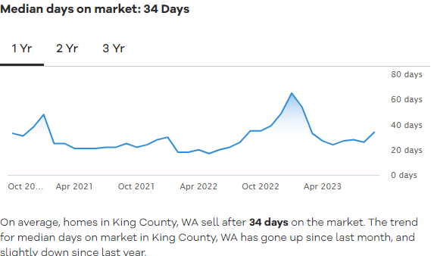
Current Real Estate Trends In King County
The median listing home price in King County, WA was $854.9K in August 2023, trending down -2.3% year-over-year.
The median listing home price per square foot was $524. The median home sold price was $850K.

Slide 3
The importance of predicting housing prices
Investment Decision-Making.
Financial Planning.
Tenant and Landlord Decisions
Machine Learning for better pricing predictability.

Slide 4
Regression Model Summary
Model Type: Ordinary Least Squares (OLS) Regression
Dependent Variable: Housing Price (Price of Properties)
Independent Variable: Price, SQFT Living Space, Bathroom, Grade, Suburb price category, Suburb Median
Strength of Model : 0.649 R-squared (Approximately 65% of the variation in housing prices is explained by the model)
Relevancy of Model: 3418 F-statistic (A high F-statistic indicates the model is statistically significant)

Slide 5
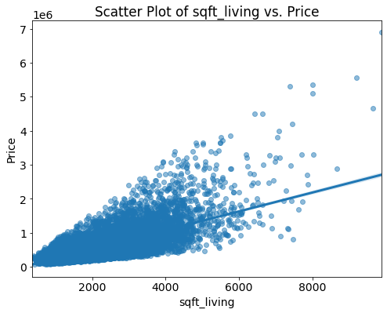
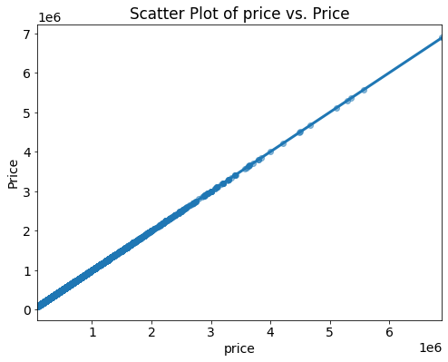
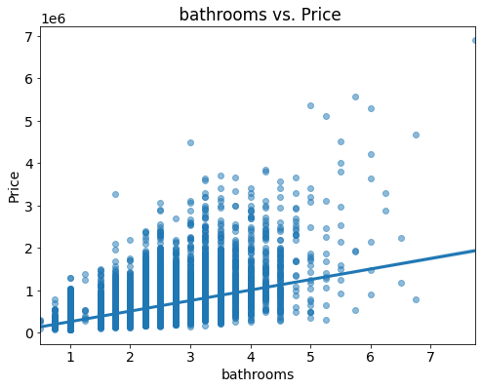
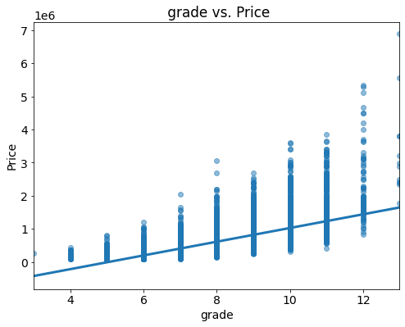
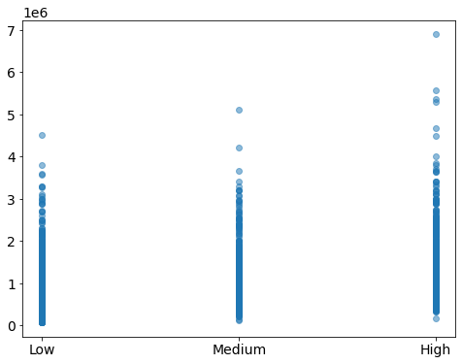
Key Predictors
sqft_living
Price
Bathrooms
Grade
Suburb Price median

Slide 6
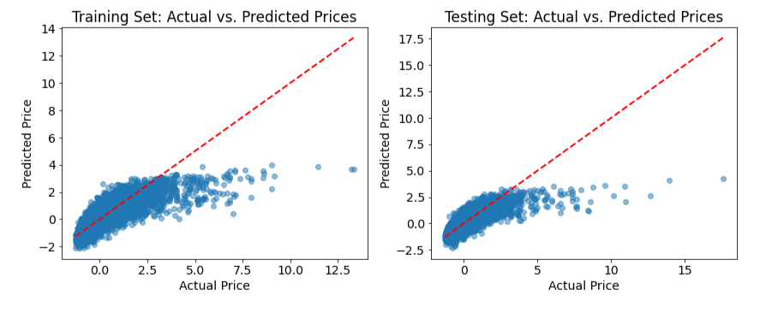
Train & Test Results Mean Squared Error (MSE) and Mean Absolute Error (MAE)
Training Set MSE: 0.39
Training Set MAE: 0.41
Testing Set MSE: 0.43 Testing Set MAE: 0.42

Slide 7
Key takeaways
The model provides a solid understanding of the factors influencing housing prices, making it valuable for real estate professionals, investors, and policymakers.
With an R-squared value of 0.649, the model explains a significant portion of price variability, offering reliable price predictions.
The F-statistic indicates that the model's overall performance is statistically significant, reinforcing its reliability.
The model's application can aid in making informed real estate investment and pricing decisions.
In summary, this regression model provides valuable insights into the housing market and can be used to predict housing prices with reasonable accuracy.

Slide 8
Thank you
Sumali Wickramarachchi
sumaliwick11@gmail.com
GitHub: @SumaliWick
LinkedIn profile: Sumali Wickramarachchi
https://www.linkedin.com/in/sumali-wickramarachchi-3a296356/

